Slide 1











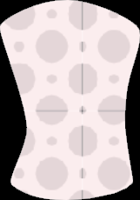




Avatar character library
DECEMBER 2021

Slide 2
Using the avatar character library
Introduction
In this document, you will ﬁnd a range of example avatars drawn in two styles – a full-color solid ﬁll style, and a simpliﬁed outlined style which uses a reduced set of 3-4 colors from the extended color palette.
In your own projects, you may use these avatars as they are, adapt them to your needs, or create entirely new avatars. A range of hairstyles, clothing, shoes, and accessories have been included to get you started.
Patterns and textures can be used on your avatar’s clothing, but only one or two pieces of clothing per avatar so that the composition does not become too busy and overly patterned.
Our avatars are designed to be diverse and representative of the entire human population – utilizing realistic skin and hair colors. They should stand and move in a natural and human fashion, and cast a shadow in their environment to help them to appear grounded in the scene. Body language, clothing and accessories should be used in lieu of facial expressions, wherever possible, to help with storytelling and expressing emotion.
For more information, please refer to the illustration guidelines.

Slide 3
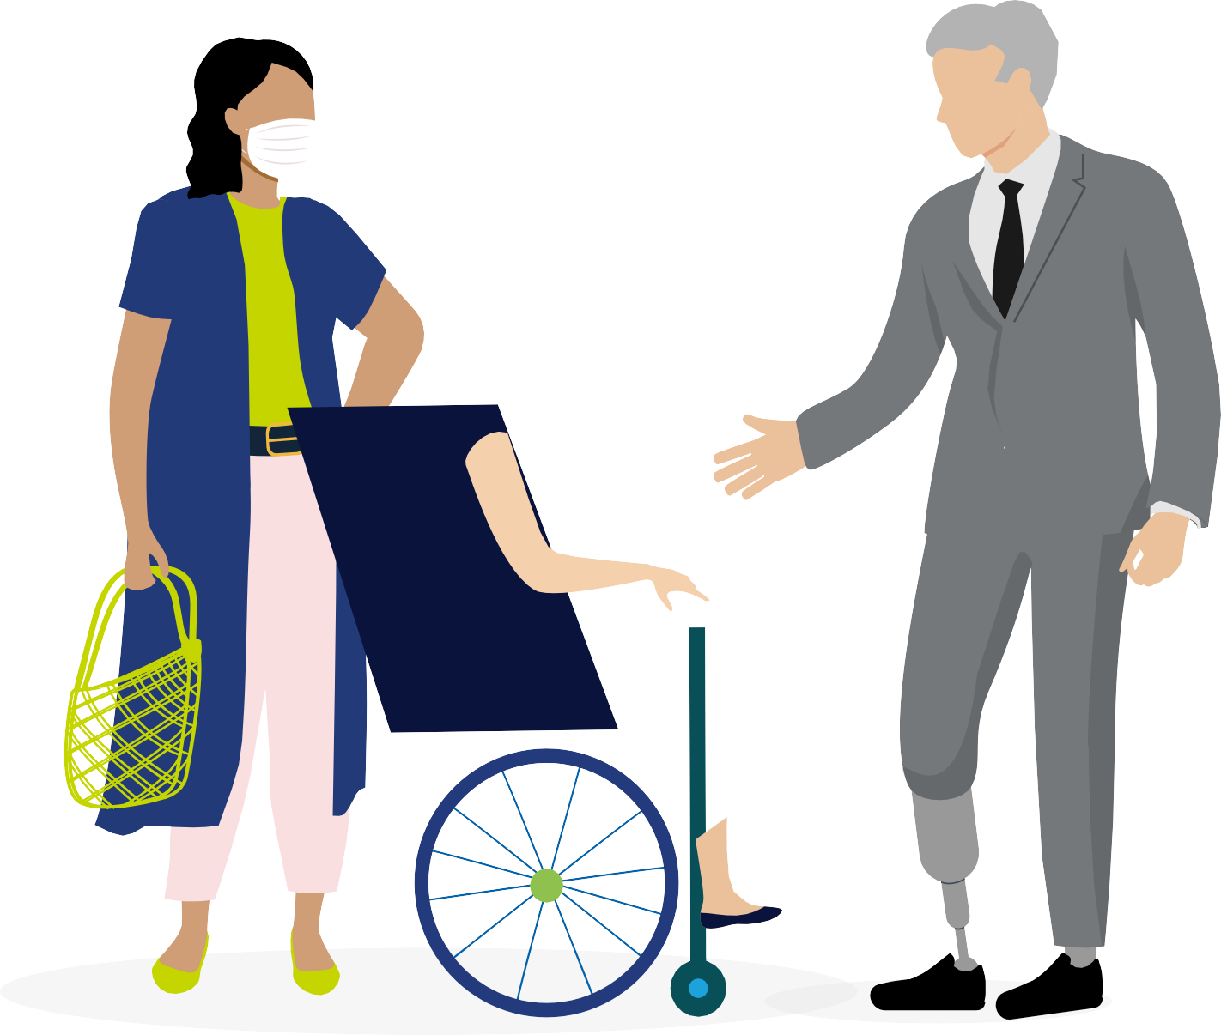

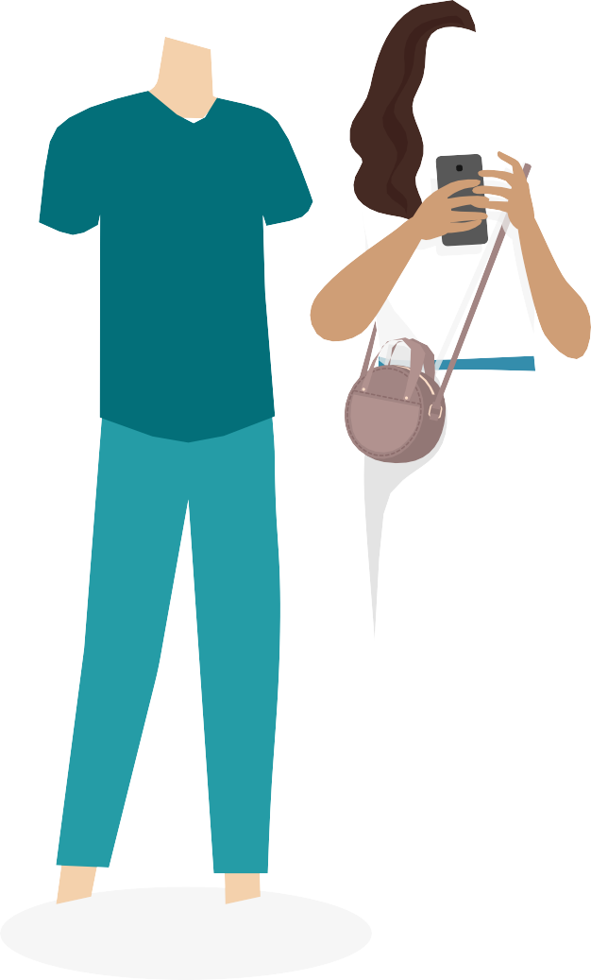
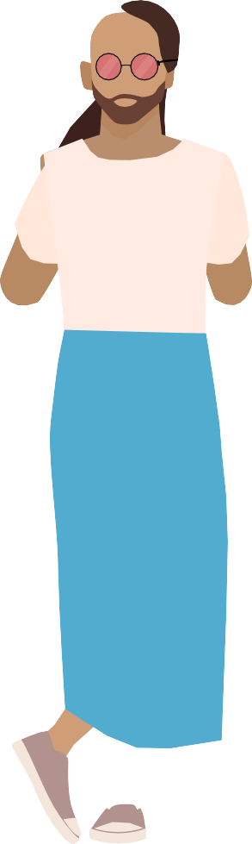






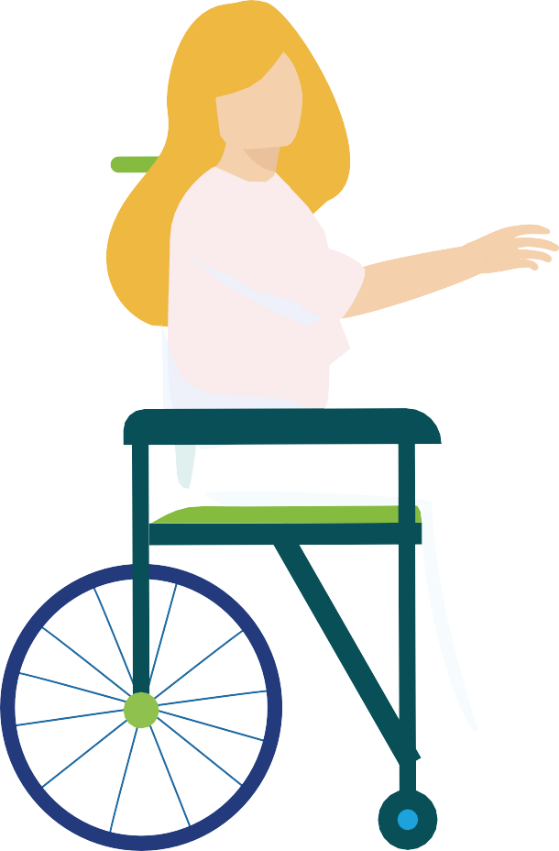









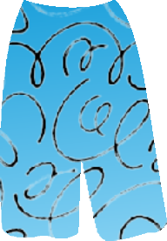






Introducing character set A
Solid-ﬁll characters

Slide 4

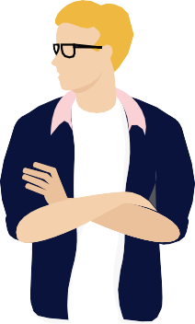
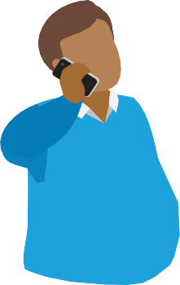
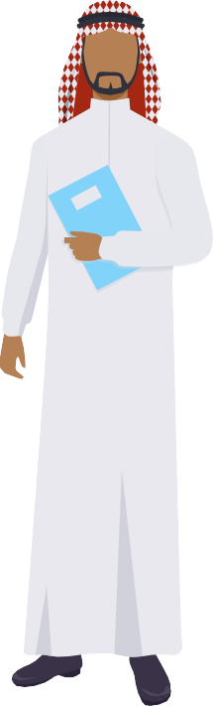
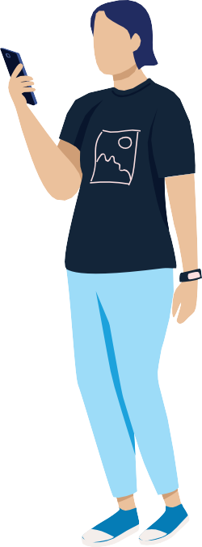

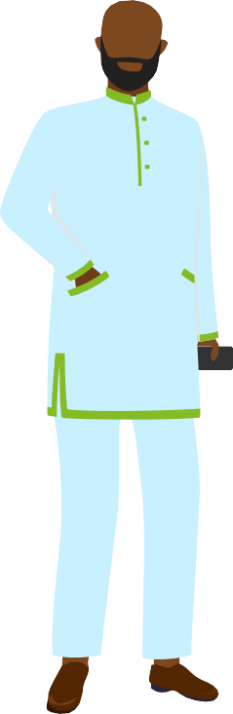

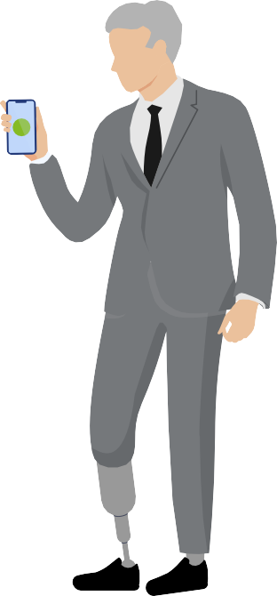


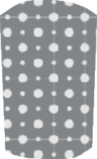

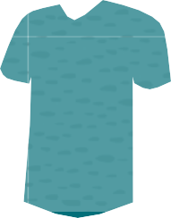

























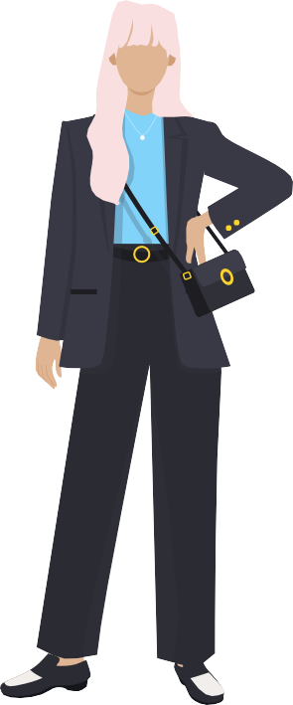
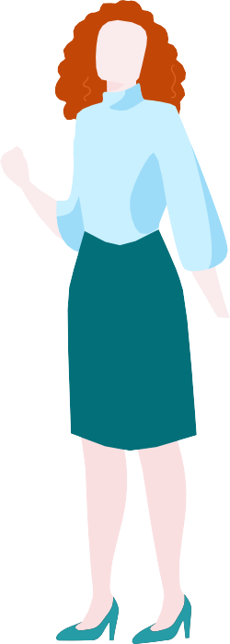

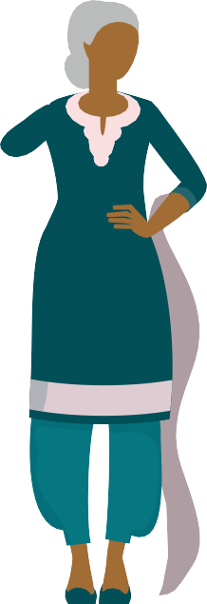


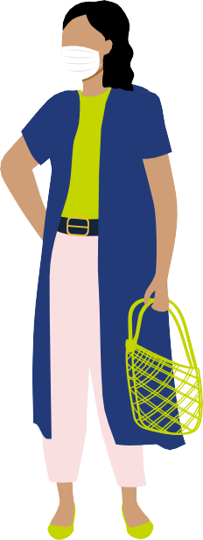
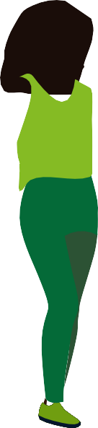
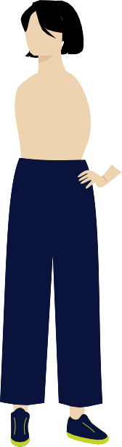



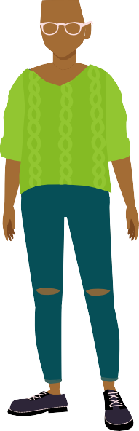





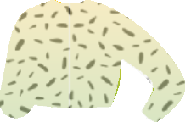


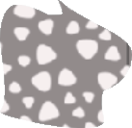





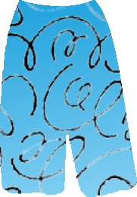









Character set A
Solid ﬁll characters
01
02
03
04
05
06
07
08
09
10
11
12
13
14
15
16
17
18
19
20
21
22
23
24

Slide 5
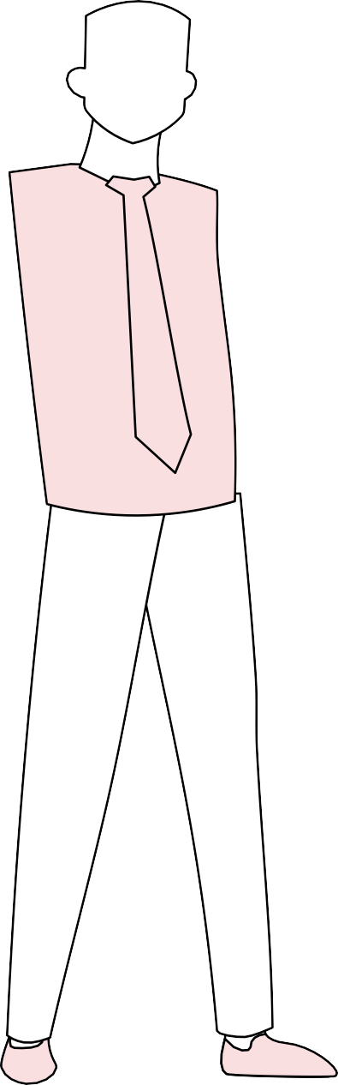
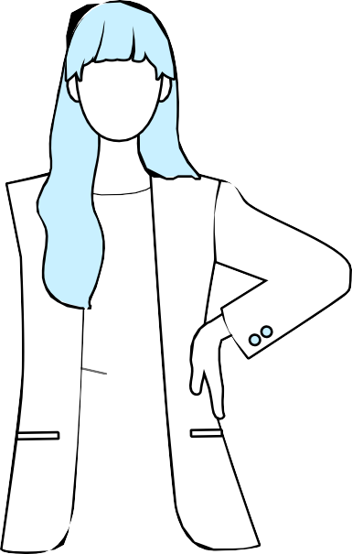
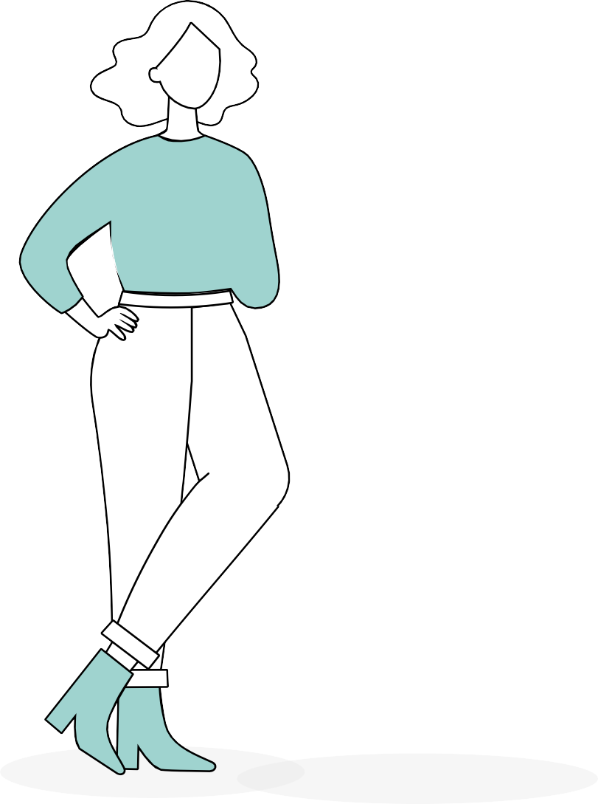
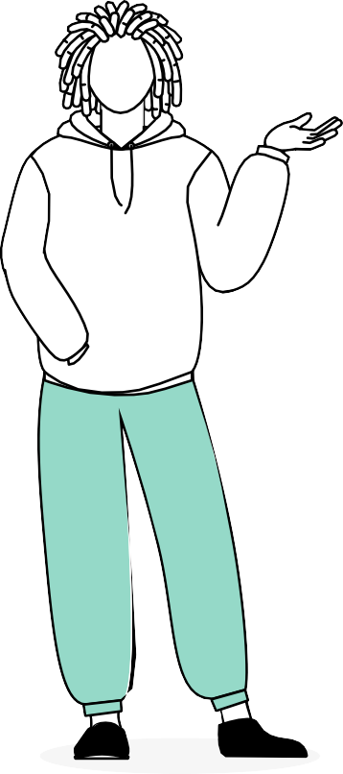
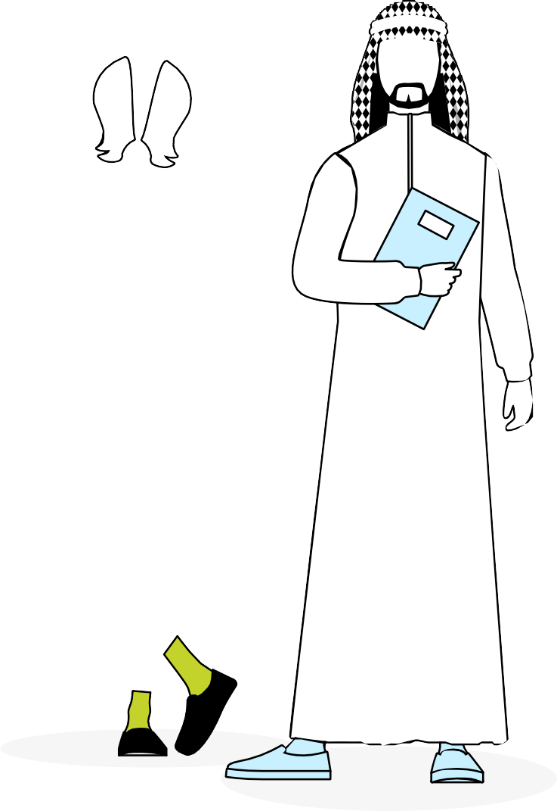
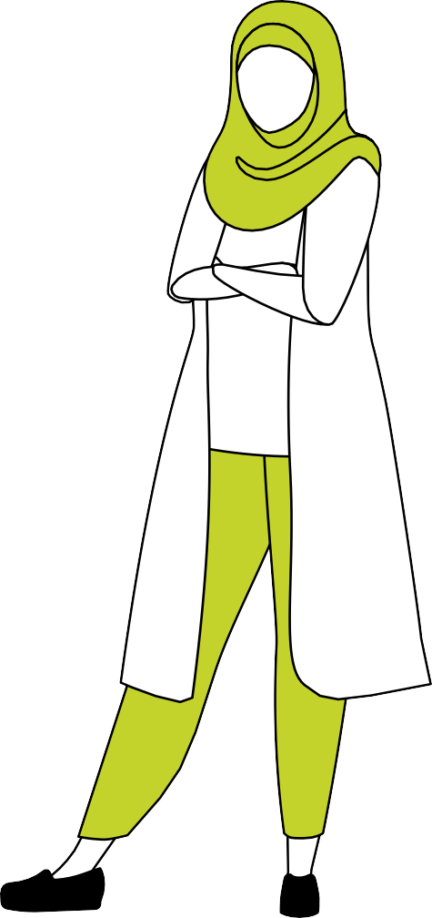
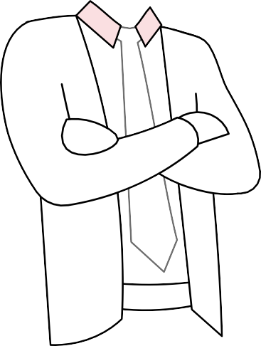

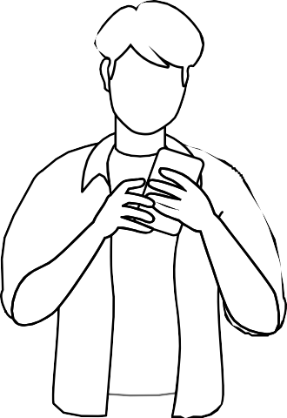

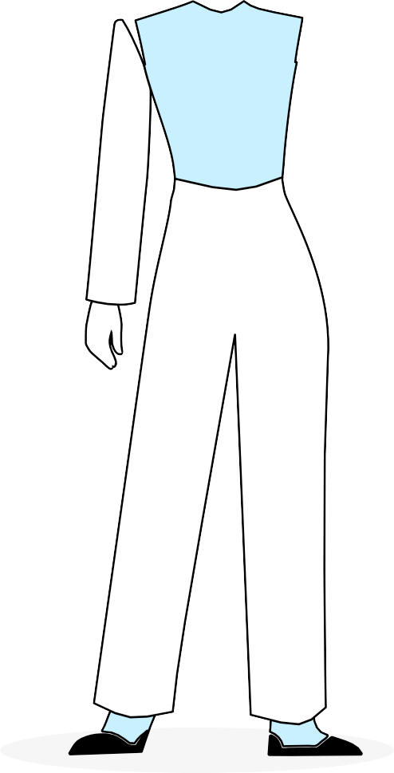
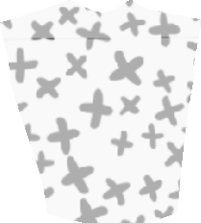
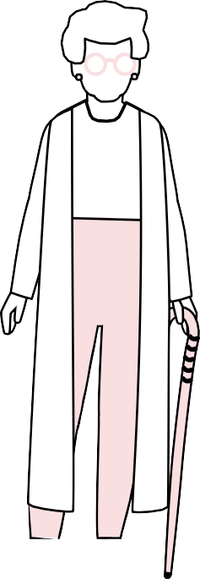
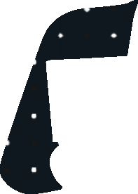
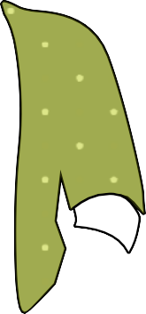



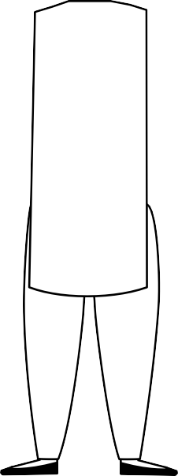

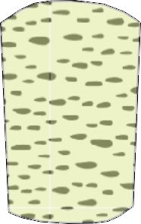
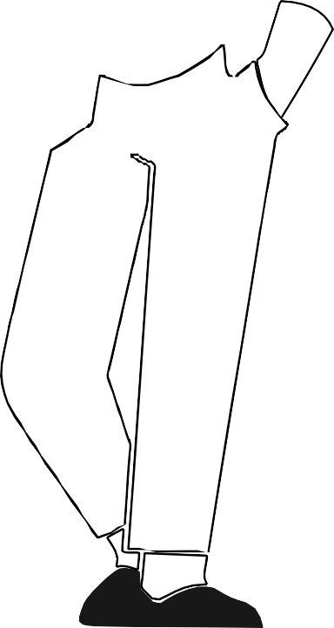


Introducing character set B
Outlined characters

Slide 6
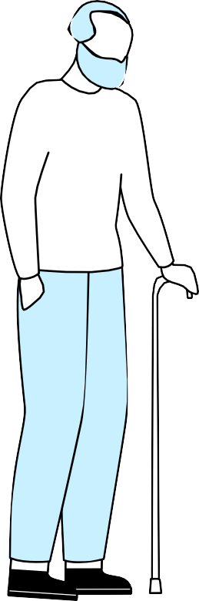
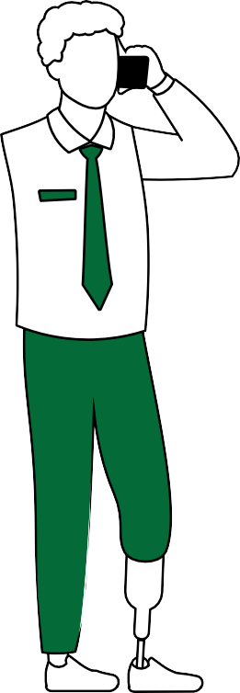
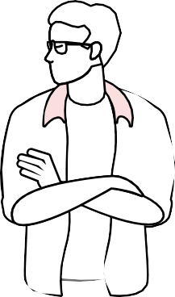
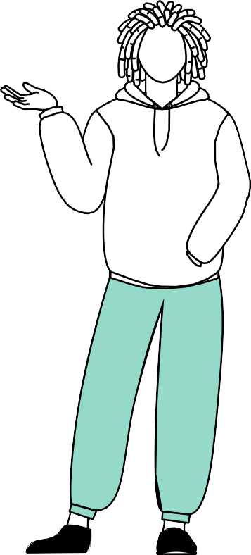
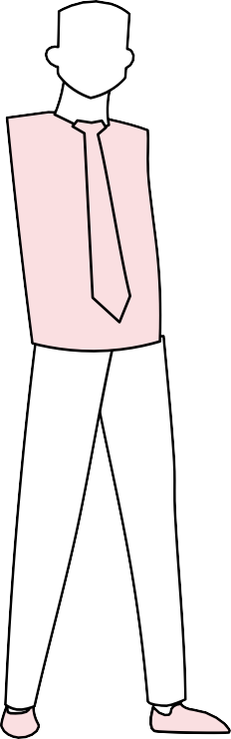
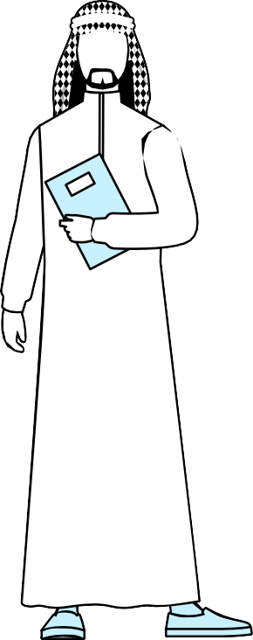
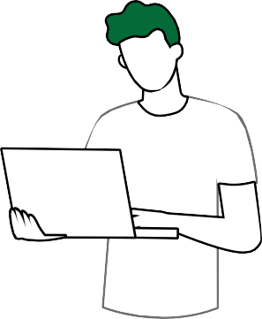
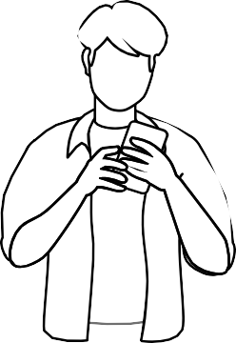
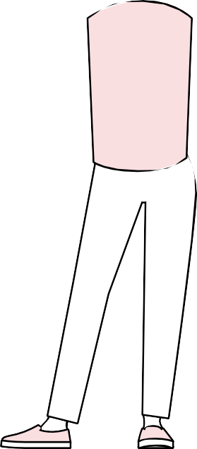




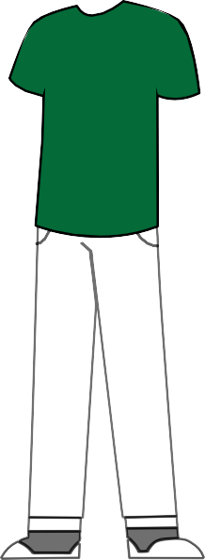






































Character set B
Outlined characters
01
02
03
04
05
06
07
08
09
10
11
12
13
14
15
16
17
18
19
20

Slide 7
































































































































Robots, humanoids, and cyborgs

Slide 8
Color palette
Deloitte brand colors
Primary palette
Secondary palette
Deloitte Green
Accessible on Black
Green 1
Green 2
Green 5
Green 7
Pantone 587 #E3E48D
R227 G228 B141 C9 M0 Y50 K0
Pantone 382 #C4D600 R196 G214 B0
C28 M0 Y100 K0
Pantone 347 #009A44
R0 G154 B68 C93 M0 Y100 K0
Pantone 350 #2C5234 R44 G82 B52
C80 M21 Y79 K64
Pantone 368 #86BC25
R134 G188 B37 C55 M0 Y100 K0
Blue 1
Blue 2
Blue 3
Blue 4
Blue 5
Blue 6
Blue 7
Green 4
Accessible on Black
Accessible Green
Accessible on Black Accessible on White
Green 6
Accessible on White
Pantone 291 #A0DCFF
R160 G220 B255 C39 M0 Y0 K0
Pantone 2915 #62B5E5
R98 G181 B229 C60 M9 Y0 K0
Pantone 299 #00A3E0
R0 G163 B224 C86 M8 Y0 K0
Pantone 7690 #0076A8
R0 G118 B168 C95 M41 Y10 K0
Pantone 7692
#005587
R0 G85 B135 C100 M45 Y0 K45
Pantone 280
#012169
R1 G33 B105 C100 M85 Y5 K22
Pantone 282 #041E42
R4 G30 B66
C100 M90 Y13 K68
Teal 1
Teal 2
Teal 3
Teal 4
Teal 5
Teal 6
Teal 7
Pantone 361 #43B02A
R67 G176 B42 C77 M0 Y100 K0
Accessible Green #26890D
R38 G137 B13
Pantone 349 #046A38
R4 G106 B56
C90 M12 Y95 K40
Pantone 566 #DDEFE8
R221 G239 B232 C17 M0 Y12 K0
Pantone 564 #9DD4CF
R157 G212 B207 C43 M0 Y23 K0
Pantone 7465 #6FC2B4
R111 G194 B180 C58 M0 Y36 K0
Pantone 326 #00ABAB
R0 G171 B171 C81 M0 Y39 K0
Pantone 7711 #0097A9
R0 G151 B169 C98 M0 Y28 K4
Pantone 7714
#007680
R0 G118 B128 C96 M0 Y30 K45
Pantone 3165 #004F59
R0 G79 B89
C100 M16 Y33 K66
White
Black
Cool Gray 2
Cool Gray 4
Cool Gray 6
Cool Gray 7
Cool Gray 9
Cool Gray 10
Cool Gray 11
Pantone Black #000000
R0 G0 B0
C0 M0 Y0 K100
Pantone Cool Gray 2 #D0D0CE
R208 G208 B206 C5 M3 Y5 K11
Pantone Cool Gray 4 #BBBCBC
R187 G188 B188 C12 M8 Y9 K23
Pantone Cool Gray 6 #A7A8AA
R167 G168 B170 C16 M11 Y11 K27
Pantone Cool Gray 7 #97999B
R151 G153 B155 C20 M14 Y12 K40
Pantone Cool Gray 9 #75787B
R117 G120 B123 C30 M22 Y17 K57
Pantone Cool Gray 10 #63666A
R99 G102 B106 C40 M30 Y20 K66
Pantone Cool Gray 11 #53565A
R83 G86 B90
C44 M34 Y22 K77
R255 G255 B255
Accessible Teal
Accessible on Black Accessible on White
Accessible Blue
Accessible on Black Accessible on White
Limited use bright colors
To be used sparingly as a highlight in typography or graphic elements.
Never used within the circle motif (which should always be Deloitte Green) Primarily for use in digital applications.
Not to be confused with links (no underlines.)
Must specify a Pantone when used in print applications (CMYK not possible.)
Bright green
Bright teal
Bright blue
Accessible Teal #0D8390
R13 G131 B144
Accessible Blue #007CB0
R0 G124 B176
#0df200
R13 G242 B0
Pantone 2286
#3efac5
R62 G250 B197
Pantone 3255
R51 G240 B255
Pantone 311
Accessible Green:
Color contrast between text and background is important on web
ability to perceive the information.
Limited use functional colors
Red
Orange
Yellow
Pantone 485 #DA291C R218 G41 B28
C0 M95 Y100 K0
Pantone 144 #ED8B00 R237 G139 B0
C0 M51 Y100 K0
Pantone 116 #FFCD00 R255 G205 B0
C0 M14 Y100 K0

Slide 9
Expanded color palette (for avatar use only)
Skin and hair colors are to be kept realistic. Colors like blues and greens may be used as hair colors, as hair can be dyed to those colors, but skin colors should always be natural.
Skin and hair
#321709 | #3f1a05 | #542701 | #713c1a | #7d4921 | #996536 | #ac8456
R50 G23 B09 | R63 G26 B05 | R84 G39 B01 | R113 G60 B26 | R125 G73 B33 | R153 G101 B54 | R172 G132 B86
C53 M73 Y78 K76 | C48 M76 Y83 K71 | C42 M75 Y94 K59 | C36 M74 Y98 K41 | C35 M69 Y97 K34 | C32 M59 Y88 K18 | C30 M46 Y73 K08
#ba8f72 | #cf9e76 | #ecc19c | #f4d1ad | #efd4b1 | #fbdfe2 | #fbeced
R186 G143 B114 | R207 G158 B118 | R236 G193 B156 | R244 G209 B173 | R239 G212 B177 | R251 G223 B226 | R251 G236 B237
C27 M44 Y57 K3 | C19 M39 Y57 K0 | C7 M25 Y39 K0 | C3 M18 Y32 K0 | C5 M16 Y31 K0 | C0 M14 Y4 K0 | C0 M7 Y3 K0
To be used sparingly as a hair color or in speciﬁc religious or cultural clothing
Hair
Green 6
#000000 | #a52713 | #c24807 | #db6221 | #efb941 | #ﬀd332 | #046A38
R0 G0 B0 | R165 G39 B19 | R194 G72 B7 | R219 G98 B33 | R117 G120 B123 | R255 G211 B50 | R4 G106 B56
C0 M0 Y0 K100 | C24 M96 Y100 K18 | C17 M84 Y100 K7 | C10 M74 Y100 K1 | C6 M28 Y86 K0 | C1 M15 Y89 K0 | C90 M12 Y95 K40
Cool Gray 2
Cool Gray 7
Blue 7
Blue 4
Teal 5
#f2f2f2
R242 G242 B242 C4 M2 Y2 K0
#D0D0CE
R208 G208 B206 C5 M3 Y5 K11
#97999B
R151 G153 B155 C20 M14 Y12 K40
#041E42 R4 G30 B66
C100 M90 Y13 K68
#243b7a
R36 G59 B122 C100 M89 Y23 K9
#0076A8
R0 G118 B168 C95 M41 Y10 K0
#0097A9
R0 G151 B169 C98 M0 Y28 K4

Slide 10




















Patterns and textures
Please refer to the Global Illustration Guidelines for explanation on how to apply these patterns and textures to colors using blending modes.
01
02
03
04
05
06
07
08
09
10
11
12
13
14
15
16
17
18
19
20

Slide 11




















Patterns and textures
Application examples
01
02
03
04
05
06
07
08
09
10
11
12
13
14
15
16
17
18
19
20

Slide 12


















































Extra characters

Slide 13







































Extra characters

Slide 14




























Extra characters

Slide 15




























































Extra characters

Slide 16




















































Extra characters

Slide 17







































Extras for adaptation
Hand and devices

Slide 18

















Extras for adaptation
Head coverings

Slide 19






















Extras for adaptation
Shoes

Slide 20































































































































Extras for adaptation
Hairstyles, bodies, and accessories

Slide 21


























































Extras for adaptation
Hairstyles, bodies, and accessories

Slide 22
























Extras for adaptation
Hairstyles, bodies, and accessories

Slide 23








































Extras for adaptation
Clothes and accessories

Slide 24



























Extras for adaptation
Wheelchair users

Slide 25

Deloitte refers to one or more of Deloitte Touche Tohmatsu Limited
(collectively, the “Deloitte organization”). DTTL (also referred to as “Deloitte separate and independent entities, which cannot obligate or bind each related entity is liable only for its own acts and omissions, and not those
of each other. DTTL does not provide services to clients. Please see www. deloitte.com/about to learn more.
© 2021. For information, contact Deloitte Touche Tohmatsu Limited.

